Slide 1
GROUP ONE Presentation

Slide 2
INTRODUCTION
Understanding student study habits is essential for improving academic performance and resource planning.
This report investigates the average number of hours UCU students dedicate to studying each day. By
collecting and analyzing data from a diverse sample of students across various faculties, we aim to uncover
patterns in study behavior and highlight areas for potential academic support. The findings offer insights into
how students manage their time and suggest recommendations for fostering more effective study routines.

Slide 3
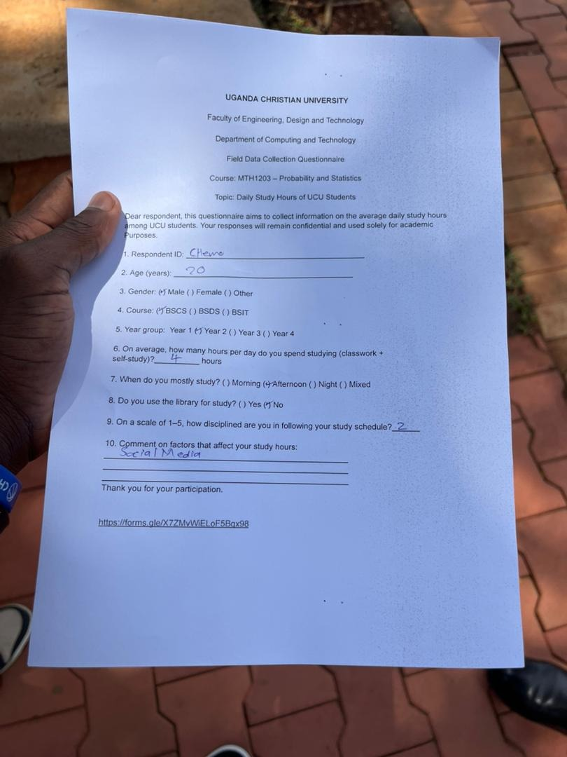
Methodology
Sampling Method: Random
Data Collection: Structured questionnaire (face-to-face)
Data Captured:
Demographics (name, age, gender, course)
Study hours per day
Study time preference (morning/afternoon/evening/mixed)
Library usage (Yes/No)
Factors affecting study time
Ethics: Consent and confidentiality maintained

Slide 4
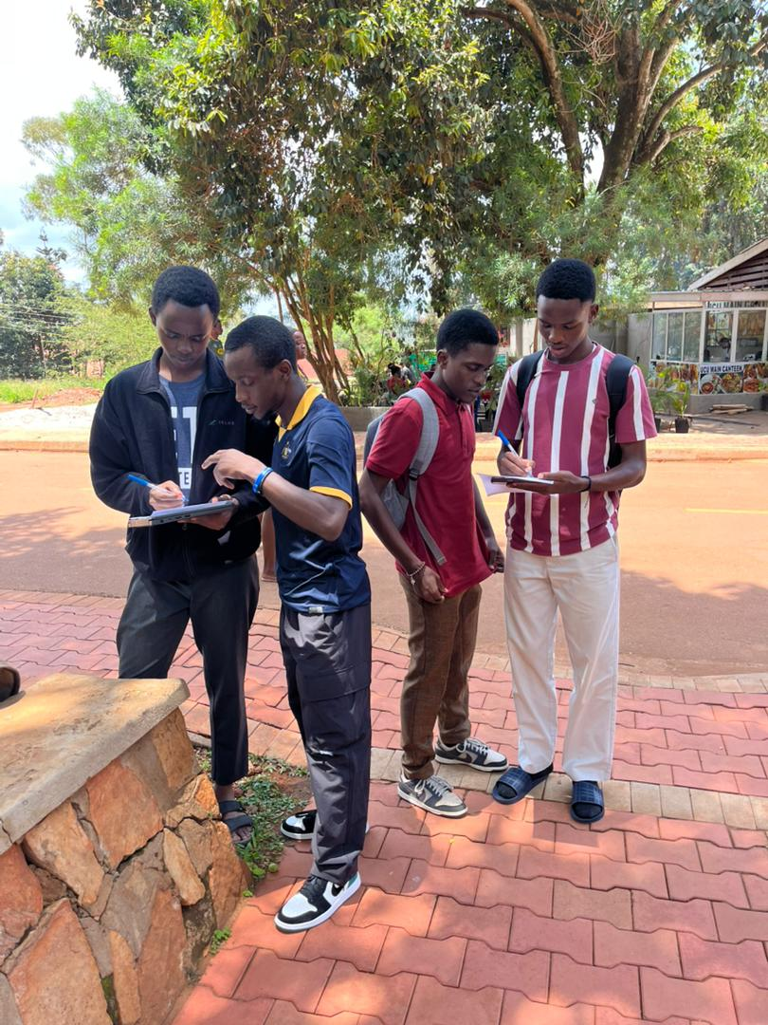
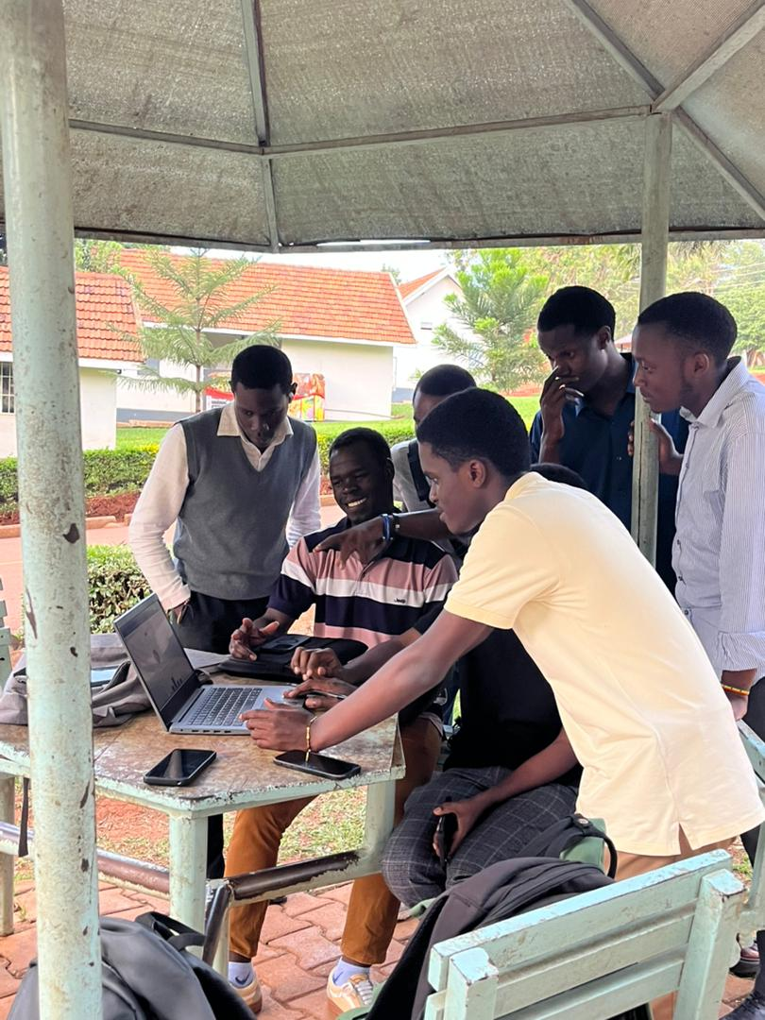
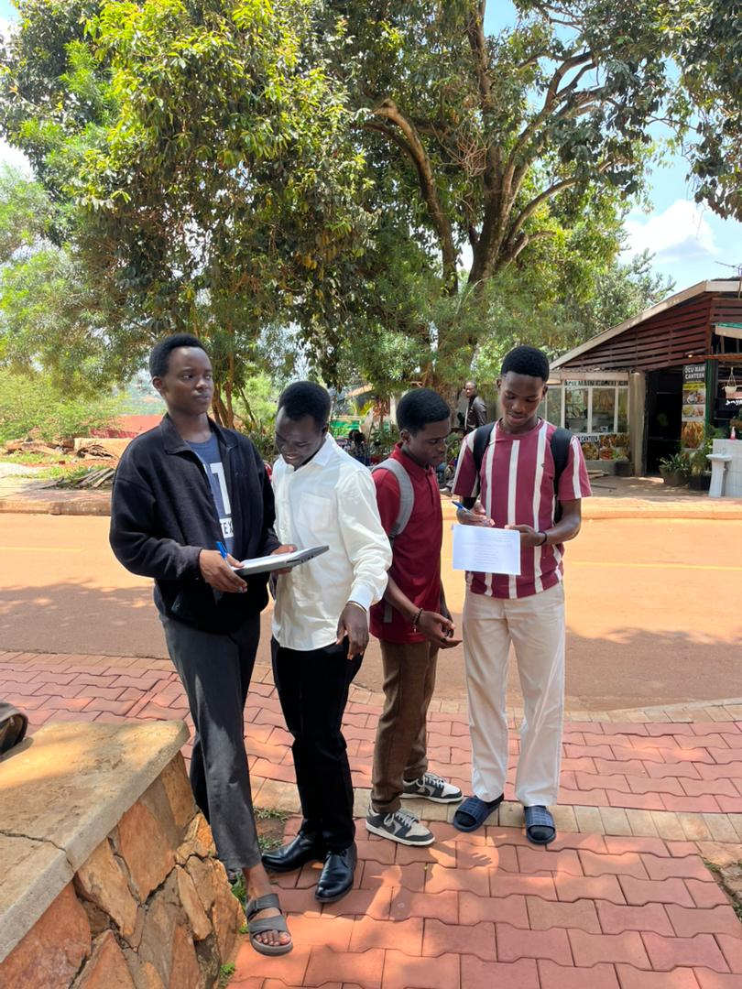
GROUP MEMBERS IN THE FIELD

Slide 5
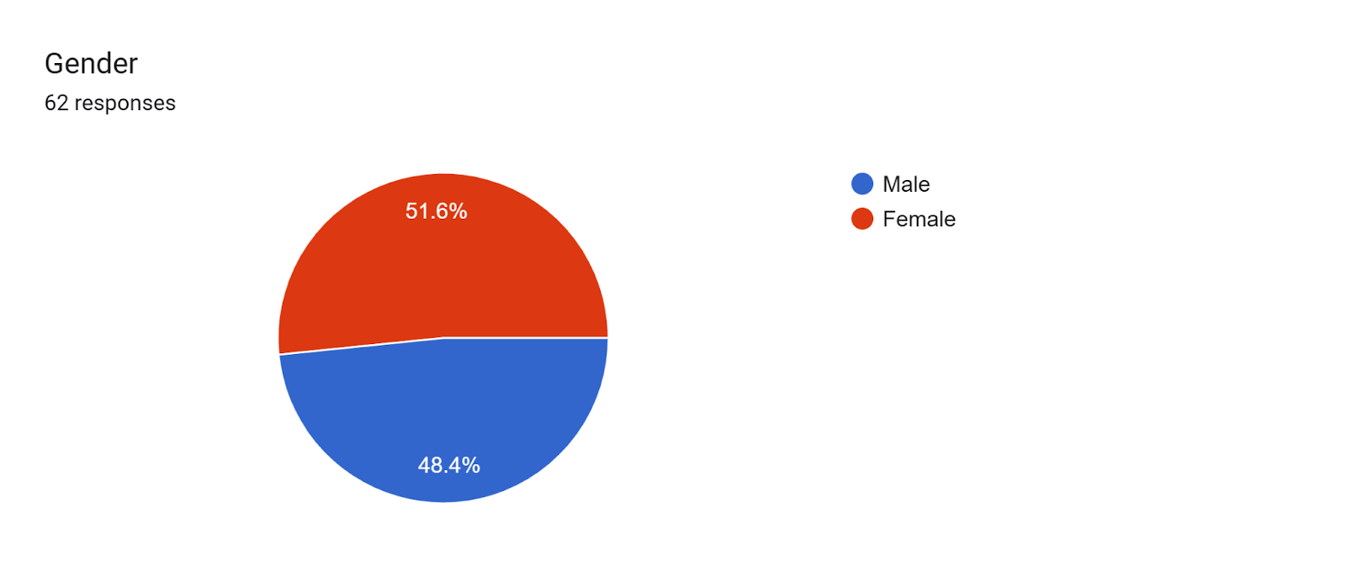
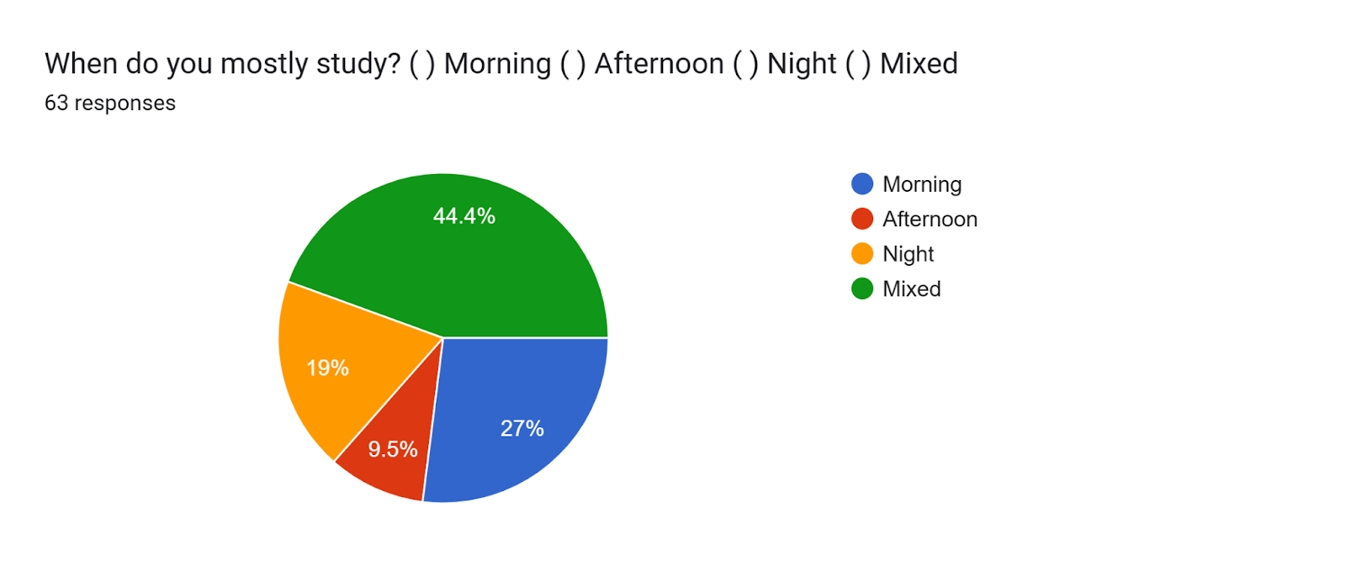
GRAPHS COLLECTED FROM THE FIELD
Graph showing the percentage of gender captured
Graph showing study hours of students

Slide 6
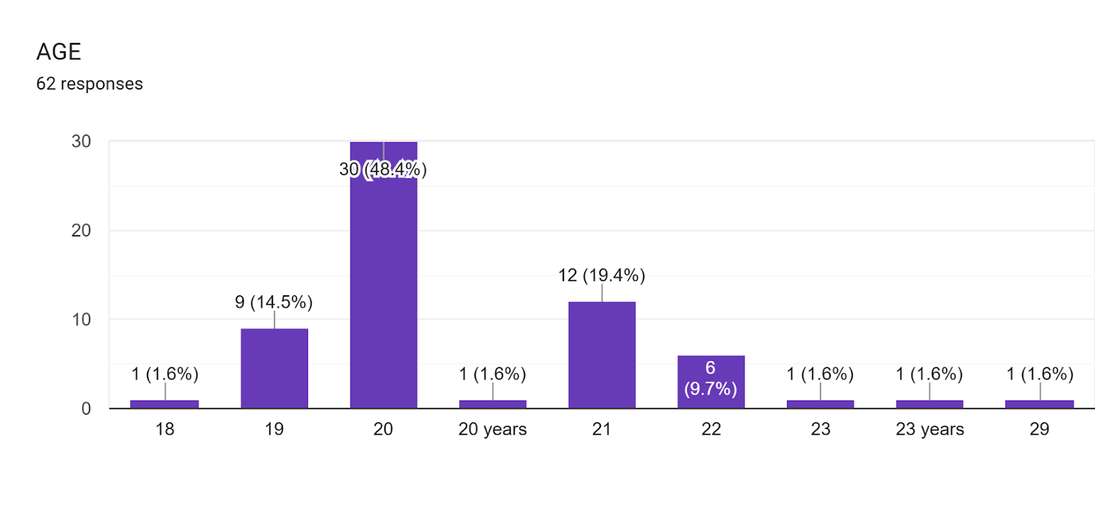
A GRAPH CHART SHOWING STUDENT’S AGES

Slide 7
Statistical Summary Ungrouped Data
Highlights
Most common study time: 4 hrs/day
Range: 1–18 hrs/day
Grouped Data Descriptive Stats:
Mean: 7.93 hrs
Median: 6.67 hrs
Mode: 4.95 hrs
Standard Deviation: 4.48 hrs
Range: 18 hrs
Interpretation: Wide variation in study habits

Slide 8
Key Insights
Law Students: Avg. 9.92 hrs/day (higher than others)
BSIT Students: Avg. 5.74 hrs/day
Library Usage: 61.9% of students use the library
Top Factors Affecting Study Hours:
Laziness, sleep, social media (TikTok)
Internet/electricity access, hunger, mood
Coursework load, lecture schedules, noise, commuting
Peer influence, part-time jobs, weather, relationships

Slide 9
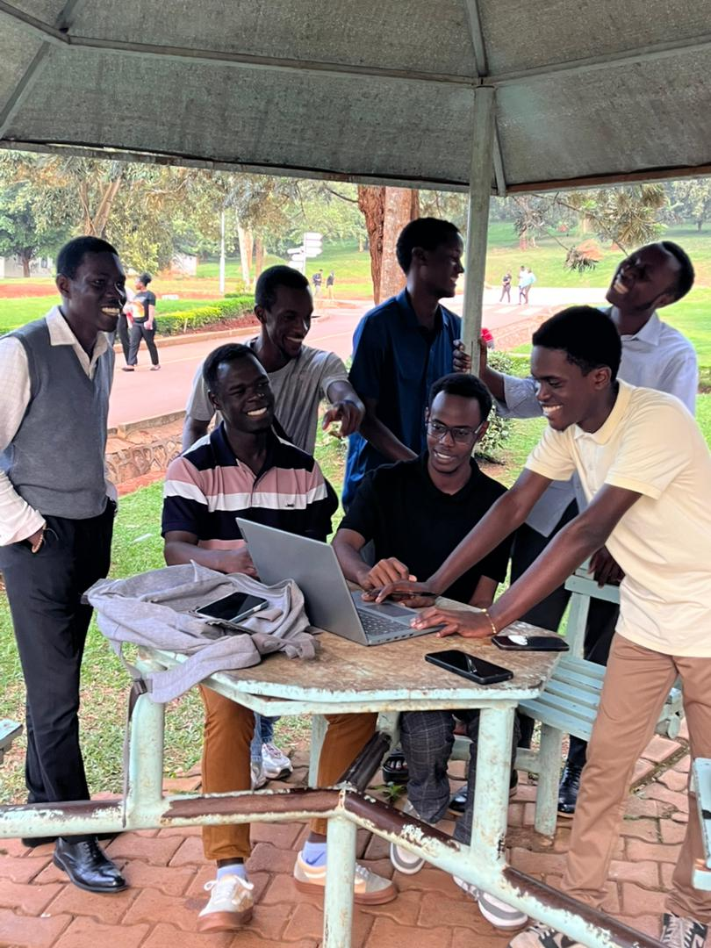
CONCLUSION AND TEAM WORK
Average UCU student studies ~8 hrs/day
Law students study significantly more
Study habits vary widely due to personal and environmental factors
Recommendations:
Encourage balanced study routines
Promote library use
Group Members & Roles:
Malish Emmanuel Abui – Questionnaire Design
Mugisha Alvin – Chart Generation
Mugisha Amos – Report Writing
Kayemba Isaac Frank – Data Verification
Nyakaana Cedric Charles – Editing
Mukisa Joel – Field Data Collection

Slide 10
Thank you!

